Slide 1
The Basics to Programming 3
A Series of Bite Size Lessons for Programming
Loops
By Tariq Chatur

Slide 2
Introduction
Now that you have completed Lesson 2, you should have a basic understanding of how to use variables and if statements
Loops are the key to doing a task more than once without repeating code
Loops will be one of your most useful tools when it comes to building programs and will likely be referenced in future lessons
In this lesson we will look at two types of loops. For loops and While loops.

Slide 3

For Loops
For Loops are how we cycle through a task multiple times with an index.
The standard set up for a For Loop is:
* $i++ is the same as $i = $i + 1
** The # symbol is for comments, notes left my programmers that aren’t run by the code
Breakdown of the for loop construction:
for : This is the indicator that a for loop is being initiated
$i = 0 : This is the initialisation of an iterator
$i –lt $max : The condition to end the loop
$i++ : When the code reaches the end of the loop it will do this operator.
#code : This is a comment indicating where the repeated task will go

Slide 4
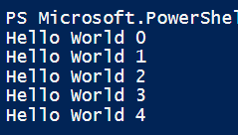

For Loop Example – Hello World
We will now use the For Loop to construct a Hello World Printing Program
In this example we will print “Hello World” followed by the number that the iterator is currently on
Please copy the code below and see if you get the same result as myself

Slide 5
Your First For Loop
In this example you can see how the loop iterates. We will highlight the steps the program goes through to accomplish this code.
Step 1: Initialise the iterator ($i = 0)
Step 2: Check to see if the condition is met ($i –lt $max) -> (0 < 5) -> All good.
Step 3: Execute Code (Write-Host (“Hello World ” + $i)) -> (Write-Host(“Hello World ”+ 0)) -> Print: Hello World 0
Step 4: Execute Iteration code ($i++) -> ($i = 1)
…
Execute Steps 2-4 with the new $i value until the condition is no longer met
…
Step n: Continue down the script
*It is standard to start with $i = 0 because in programming many references use the index 0 as the first value

Slide 6
Reminders
When {} brackets are used to separate code, remember that variables initialised in within them cannot be referenced outside. Go to Lesson 2 to revisit the concept of Scope
Loops have the potential to go infinite, make sure that the variables for your loops end. Most compilers can catch infinite loops, but always be careful just in case they can’t.

Slide 7
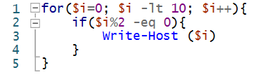
For Loop Exercise
Make a script that counts from 0 to 10 but only the even numbers
Restrictions:
You can only write code in the For Loop
Answer
Drag Answer Box Here to see Answer

Slide 8
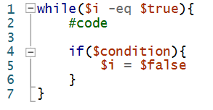
While Loops
While Loops are how we cycle through a task until some condition is met
The standard set up for a While Loop is:
** The # symbol is for comments, notes left my programmers that aren’t run by the code
Breakdown of the while loop construction:
while : This is the indicator that a while loop is being initiated
$i -eq $true : A condition to keep looping
if ($condition): The condition to end the loop also known as the break/end statement
#code : This is a comment indicating where the repeated task will go
* The end statement can be at the beginning or end of the while loop depending on whether you want an additional loop once the condition is met

Slide 9
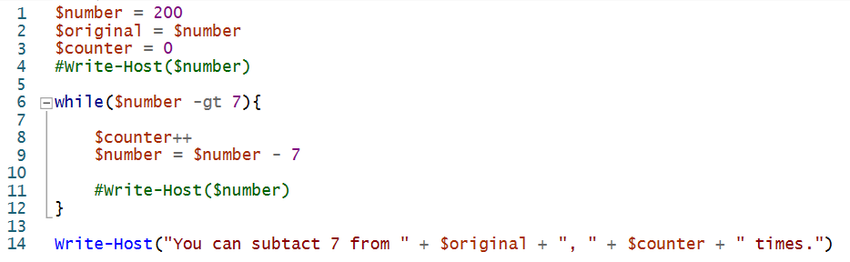

While Loop Example
We will now use a while loop to count the number of times we can subtract a number by 7 until you reach a non-positive number.
We will accomplish this by using a combination of variables and a while loop.
Copy the code below and test to see if you get the same result
*Uncomment the code to see which numbers are between $number and 0 in real time
**Change $number to 2 000 000 to test the speed of the loop
***Printing values will slow the script down which is why you will notice a large difference in computation time for the value of 2 000 000 with and without the print statement

Slide 10
Review of While Loop Example
Step 1: Initialise Variables
Step 2: Check Condition
Step 3: Subtract 7 from the number and increase the counter
…
Repeat Step 2,3 until the condition is no longer met
Step n: Print the end statement
You can see that before the while loop begins, we initialise all of our variables, this is because if we initialise them inside the loop, we wouldn’t have access to them once the loop ends.
While loops really shine, when you need to do something but are not sure for how long.
$original is used to keep track of the number since we are changing the value through the code. We generally like to keep original values and manipulate copies so we don’t lose any important information.

Slide 11
Another Reminder
While Loops are notorious for going infinite, make sure to check that your code ends.
If you are to write code that writes or opens instances of apps, you could do some serious damage if you don’t check carefully.

Slide 12
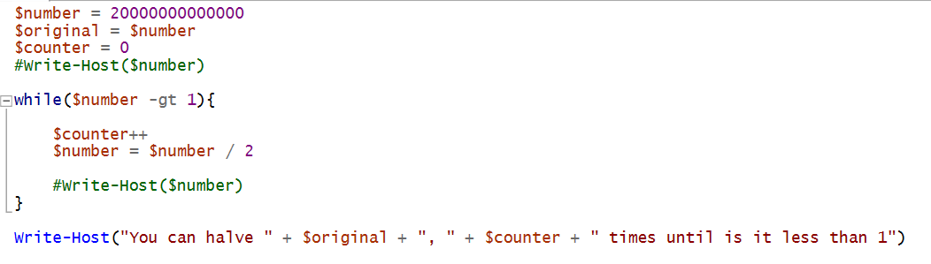
While Loop Exercise
Make a script that halves a given number until it is less than 1 then prints the number of times it was able to be halved
Restrictions:
You must use a while loop
This must function no matter what number is provided
Answer

Slide 13
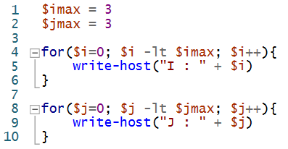

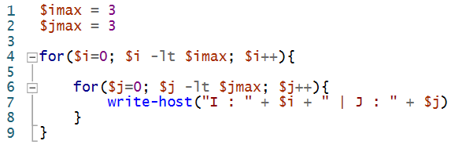
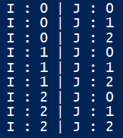
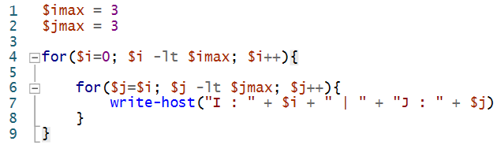
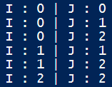
Loops in the Wild
We can use loops to replicate various behaviours, however we need to be creative if we want to get a certain patterns out of our loops. These three statements all use 2 loops but their outputs are very different.
Consecutive Loops
Nested Loops
Interconnected Loops

Slide 14
Lesson Review
For Loops are generally good for when you need to loop through a value that has a predetermined number of repetitions
While Loops are generally good for when you have an unknown number of iterations and a clear exit condition
There are more types of loops but these are the best to start with
Remember Scope and make sure you don’t loop forever

Slide 15
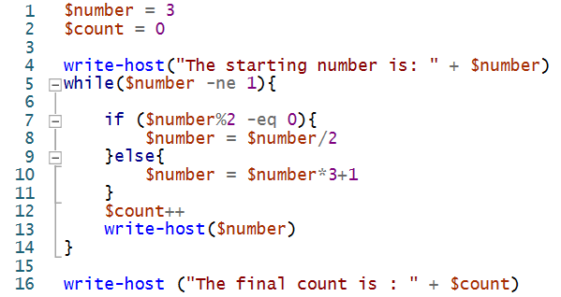
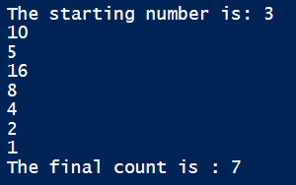
Review Exercises I
We don’t know how many times to repeat so a while loop is the most convenient
Hint
Remember to have a clearly defined end statement or else the loop will go wild
Hint
Write a program that calculates the 3n + 1 problem:
If a number is even: Divide it by 2
If a number is odd: Multiply it by 3 then add 1
- Print the steps and a final count of the number of steps until the number reaches 1
$number = 3: ->
Answer

Slide 16

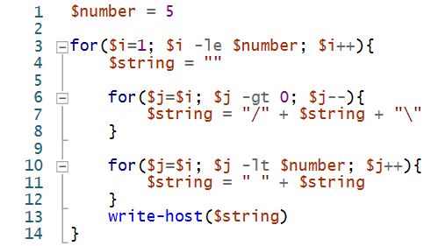

Review Exercises II
Make a String that looks like “/”+ String + “\” for $number of loops
Hint
There is a specified number of loops so you will likely use For Loops. One for the drawing and one for spacing.
Hint
Write a program that:
Takes a $number and prints a shape like this which is $number tall and 2*$number wide
$number = 3 ->
- $number = 5 ->
Answer

